Slide 1
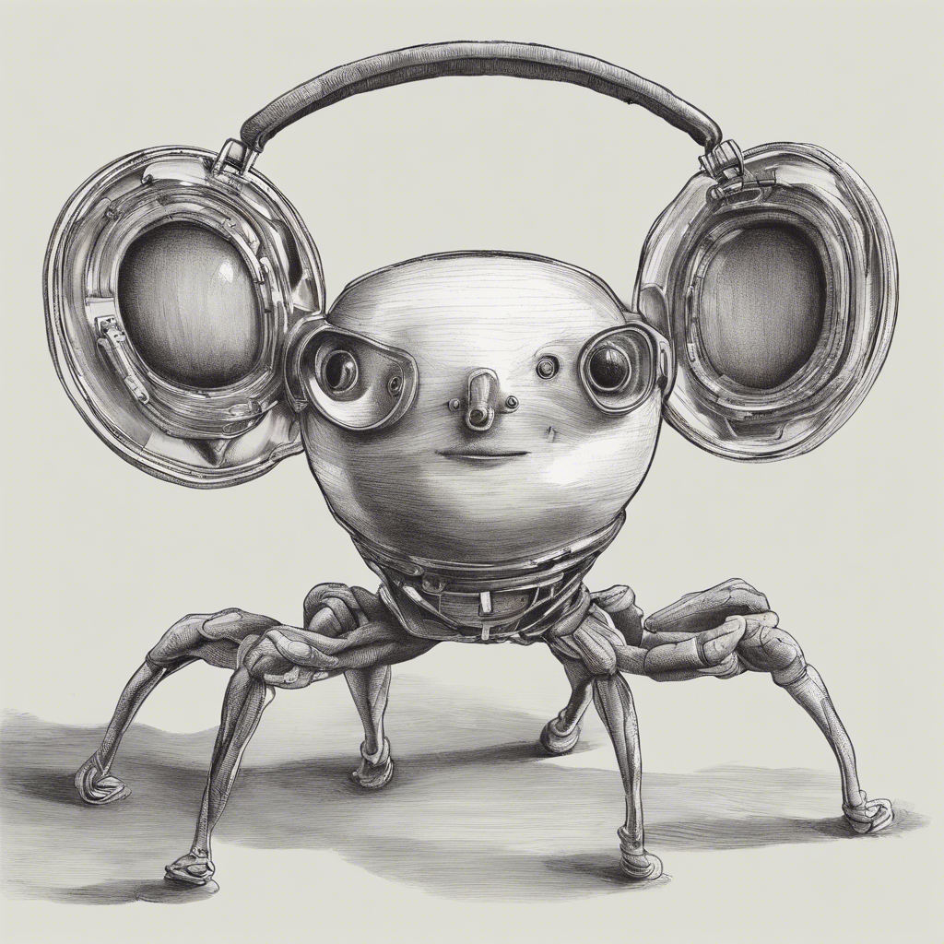
Tell me more!
A Podcast player powered by AI

Slide 2
How does it work
Podcast #1
Podcast #2
Whisper
Speaker transcribing
Text segments
Pyannote
Speaker diarization
speakers
PV Eagle*
Speaker recognition
Speaker biometrics
Voice A => Person #1
Voice B => Person #2
Voice A
Voice A
Podcast #1
Podcast #2
Voice B
* https://picovoice.ai/platform/eagle/

Slide 3

Segment 05:01 – 05:35 Person #1 “... Historically, it has always been known that we originated from ...”
Podcast #1: History of species
Sentiment: Negative
Extraction: Politics
Podcast: History of species Featuring: John Doe
Podcast #2: Humans
John Doe
Sentiment: Positive
Podcast #2: Humans
Voice biometrics
Sentiment: Neutral

Slide 4

Retrival Augmented Generation(RAG) With data streamed into Vector DB for updated searches
LLM models BGE
SQL AI Analysis Sentiment, Extraction, Classification, Summarize

